Slide 1

Hack and win 2.0
Team Name : Net Ninja
Total Member : 4

Slide 2
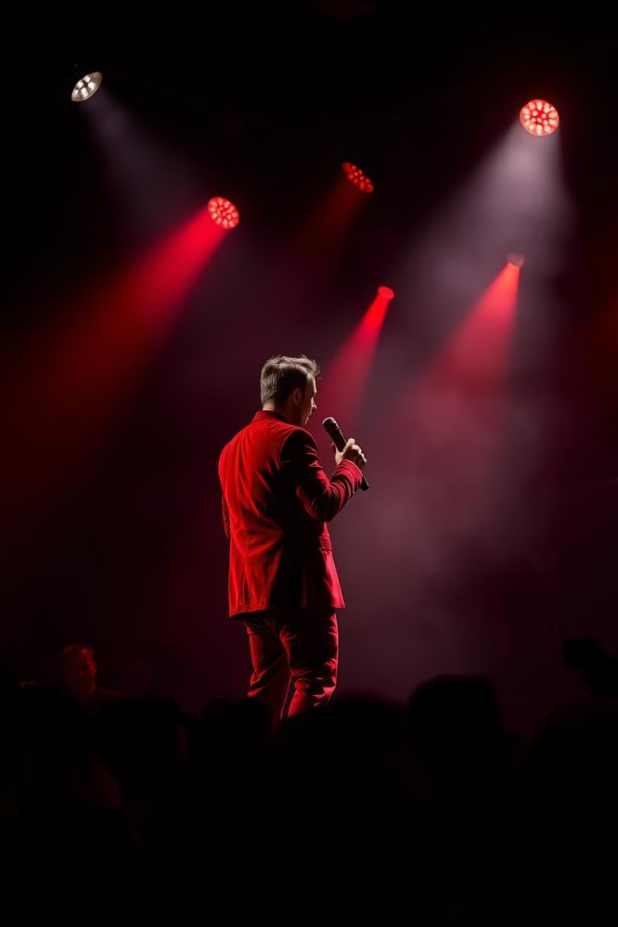
Deepfakes: A Growing Threat
Deepfakes have increased by 900% between 2019 and 2024.
1
Undermining Elections
2
Spreading Misinformation
Deepfakes create false narratives. They damage reputations, impacting voter turnout. Imagine deepfakes targeting political figures. It causes chaos during election cycles.
Deepfakes amplify fake news. They erode trust in media. They spread via social media platforms. This velocity spreads the false information.
3
AI "Nudify" Bots
Deepfakes exploit individuals. Women are victimized. Non-consensual deepfake pornography is widespread. There is an increasing number of victims.

Slide 3
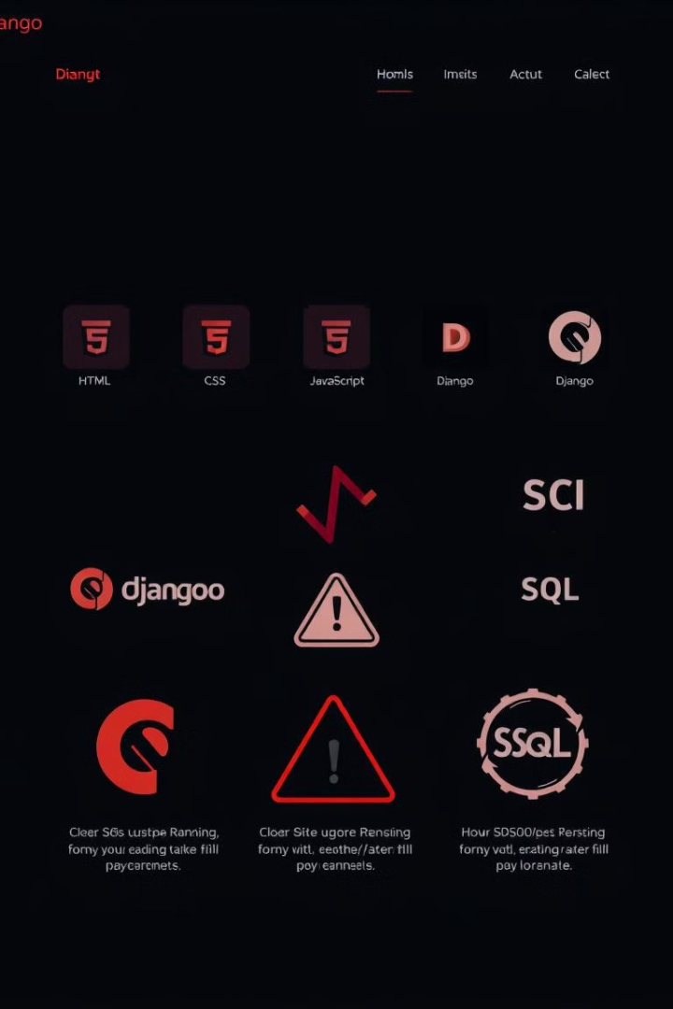
Solution : A Deepfake Detector
Our Website offers a deep dive into my website's architecture. It feature is to detect the deepfake image.
We'll explore the full-stack build with HTML/CSS/JavaScript, Django, and SQL.
We will address the critical issue of deepfakes and their implications.

Slide 4




Frontend: User Experience Focused
HTML Structure
CSS Styling
JavaScript Interactivity
A dark color palette reduces eye strain. We use charcoal grays and deep blues.
Semantic HTML5 enhances accessibility and SEO. We use article and nav tags.
Dynamic elements and user input handling are key. This is implemented using javascript.

Slide 5



Backend: Django Powerhouse
Security
1
CSRF, XSS protection
2
MVC Architecture
3
Python-Based
My website leverages Django for rapid development. Django is a Python-based backend solution. Models define data, views handle requests, and controllers manage logic.

Slide 6

Database: SQL Foundation
We leverage SQL for robust data management. It ensures data integrity and efficient retrieval.
Data Integrity
Efficient Retrieval
SQL databases provide consistency across the website.
Efficient querying of data is essential for backend operations.

Slide 7
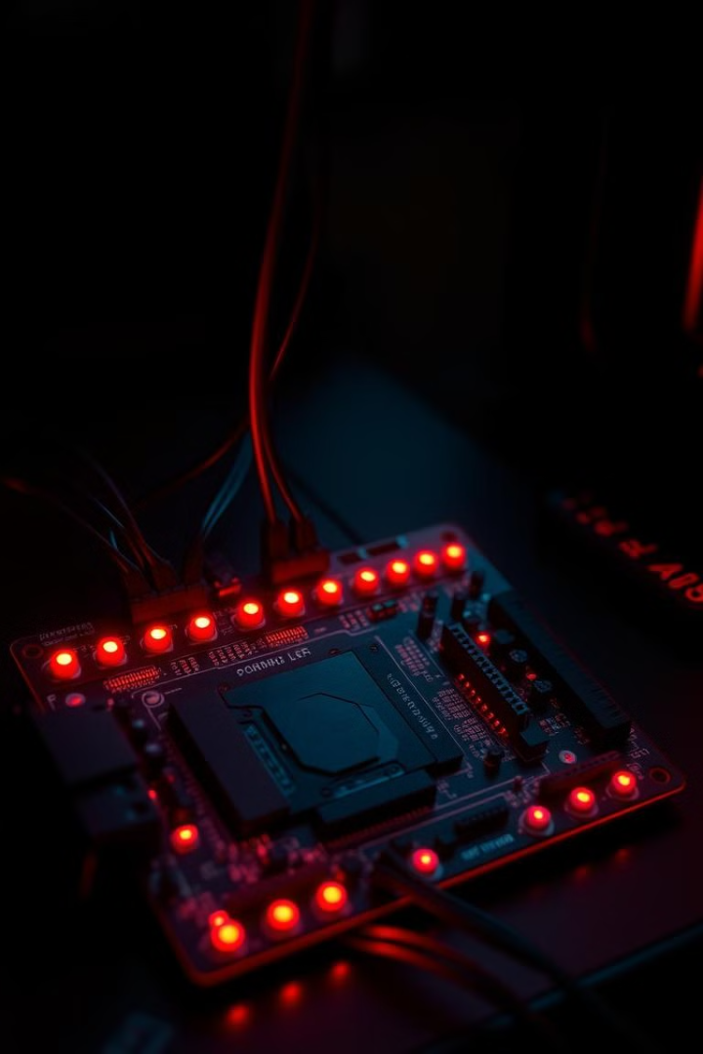
Machine learning
We are using tensorflow. keras API's XcptionNet Pre trained Model which is trained on ImageNet dataset which is then fine tuned as a deepfake detection to obtain upto max accuracy.
Cryptography
We are using ASE 256 bit algorithm for encryption and decryption of our data.
It's also provide safety for user data that it can't be gone in any type of wrong hands.

Slide 8

How Deepfake Detection Working
1
From Architecture
Its check the pixel structure, and the edges of it.
2
Frame By Frame
Our Machine learning model check frame by frame to detect any type of sudden changes like in there skin tone.
3
Face Patter.
Seeing any types of Weird blinking patterns ,Lip-sync issues, Inconsistent lighting or shadows.

Slide 9
Thank You
Team Members:
Shivam Pundir
Parag Shirivastava
Pankaj Kedia
Mehak Aggarwal

